Slide 1
MGS 723: Geodynamics
Lecture 2: Strain and Strain Rate

Slide 2
What is Geodynamics?
Dynamics of the Earth
The motion of bodies under the action of forces.
Figuring out the forces that shape motions and deformations on Earth!

Slide 3
What is Geodynamics?
Dynamics of the Earth
The motion of bodies under the action of forces.
Figuring out the forces that shape motions and deformations on Earth!

Slide 4
Strain vs. strain rate
Strain = the amount of deformation of a body
Strain rate = the amount of deformation of a body per unit time
Note: no forces involved in strain or strain rate (purely a “kinematic” descriptor)

Slide 5
Earth as a continuum
In Geodynamics, we often treat the Earth as a continuum. That is, properties vary smoothly throughout a continuous mass. Matter completely fills space (i.e., relevant for length scales >> atoms).

Slide 6
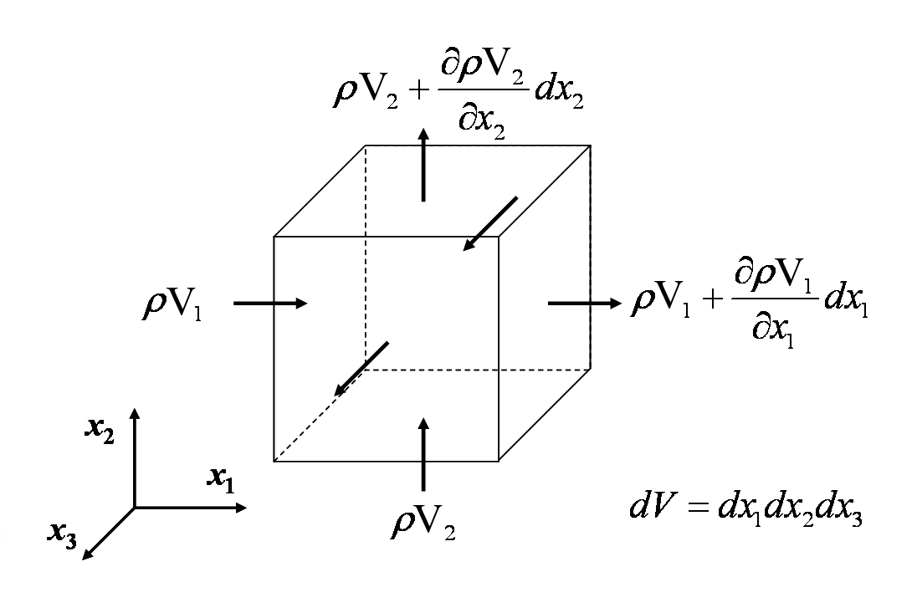
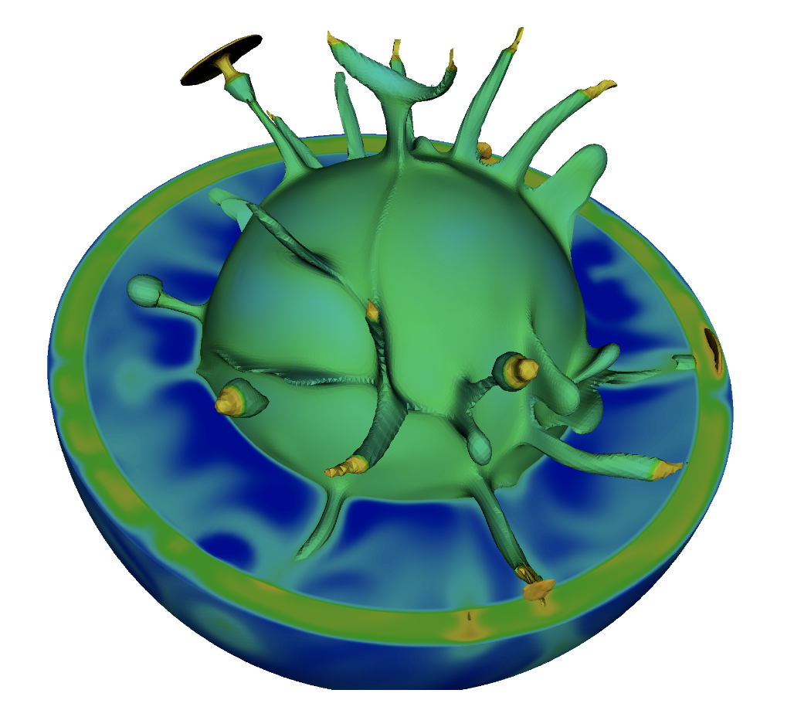
Earth as a continuum
In Geodynamics, we often treat the Earth as a continuum. That is, properties vary smoothly throughout a continuous mass. Matter completely fills space (i.e., relevant for length scales >> atoms).
Useful mathematically: Can break up the continuum into tiny chunks in order to derive fundamental equations that govern the continuum behavior (left). And solve these equations computationally (right)

Slide 7
Earth as a continuum
In Geodynamics, we often treat the Earth as a continuum. That is, properties vary smoothly throughout a continuous mass. Matter completely fills space (i.e., relevant for length scales >> atoms).
Useful mathematically: Can break up the continuum into tiny chunks in order to derive fundamental equations that govern the continuum behavior (left). And solve these equations computationally (right)
However, Earth has discontinuities (e.g., faults, joints, cracks). Need to treat these differently or use continuum approximation at a much larger scale than these features.

Slide 8

To the stylus…
To: derive generic expressions for strain and strain rate (and deviatoric equivalents).

Slide 9
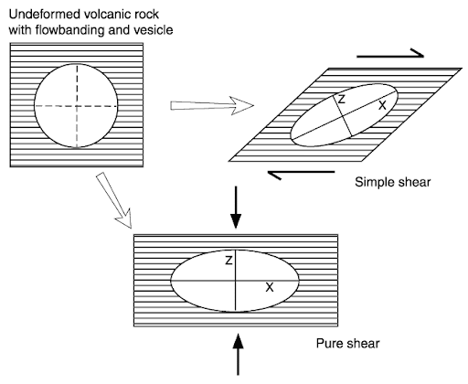
Pure vs. Simple Shear

Slide 10
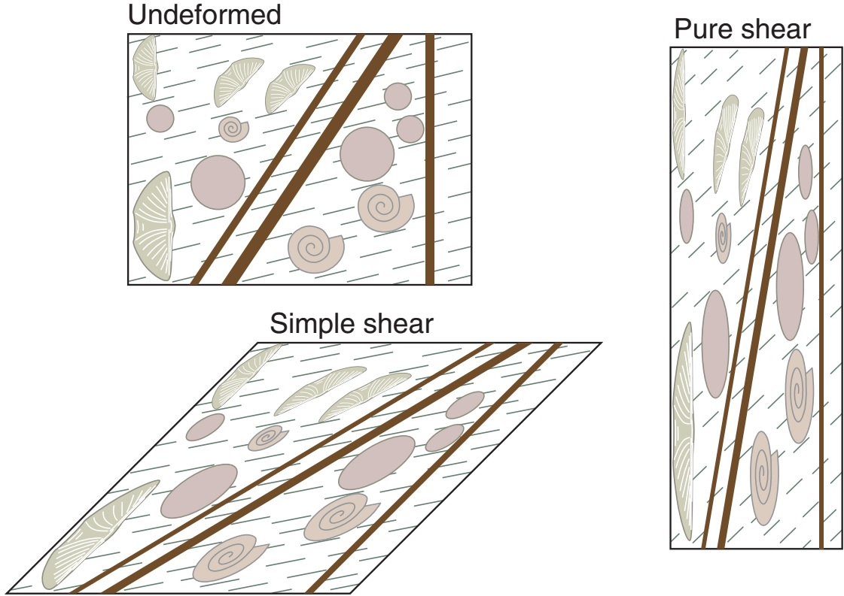
Pure vs. Simple Shear

Slide 11
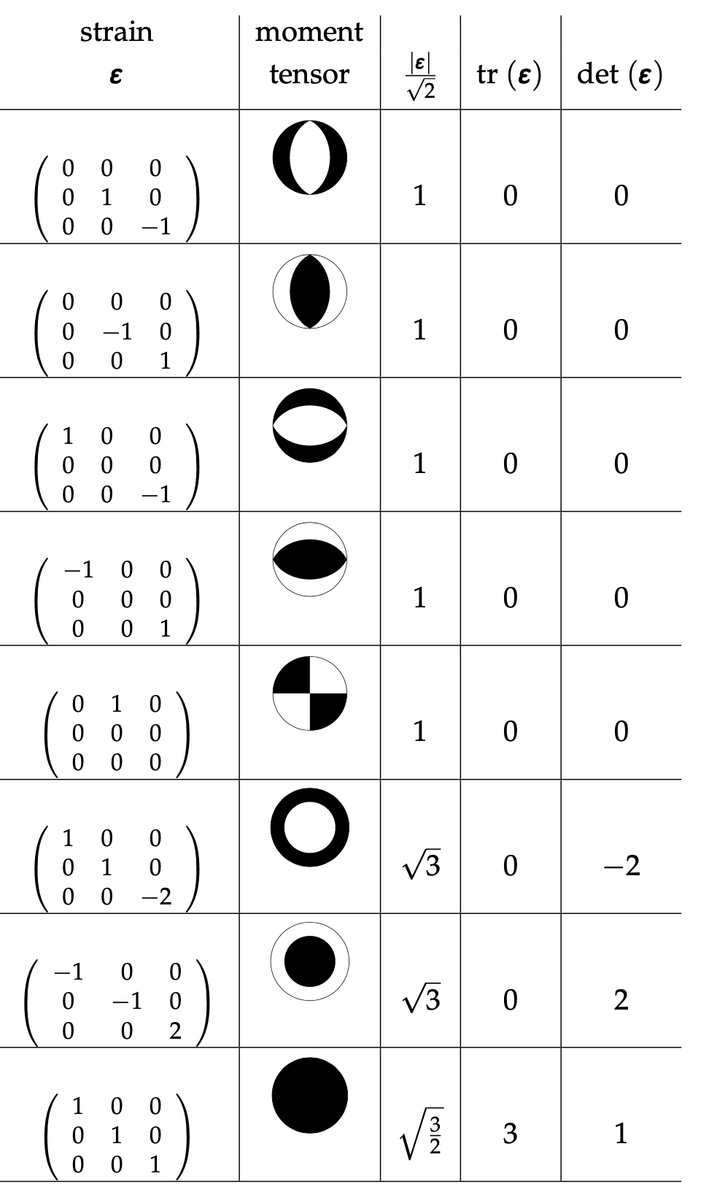
Measuring strain and strain rate on Earth
Earthquake mechanisms (strain)
Becker & Faccenna

Slide 12
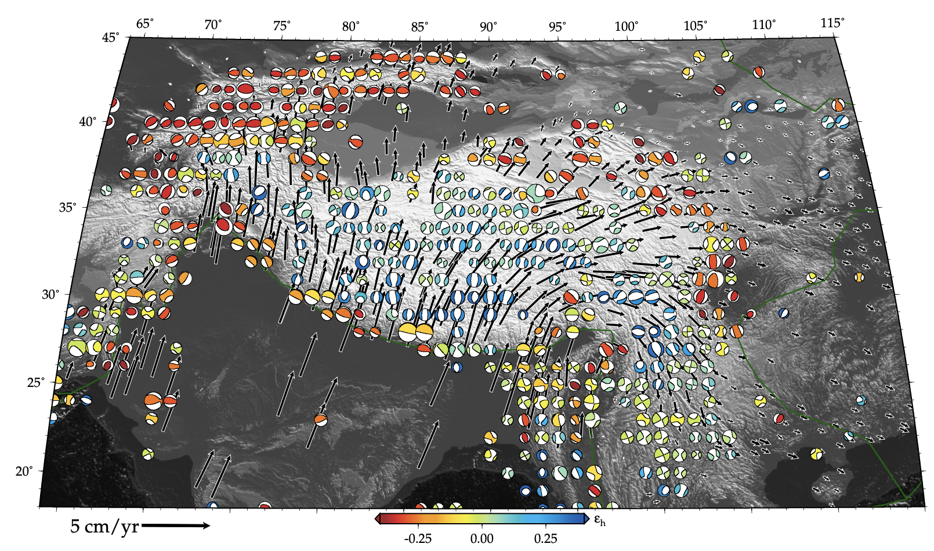
Measuring strain and strain rate on Earth
Earthquake mechanisms (strain)
Tibetan Plateau
Becker & Faccenna

Slide 13
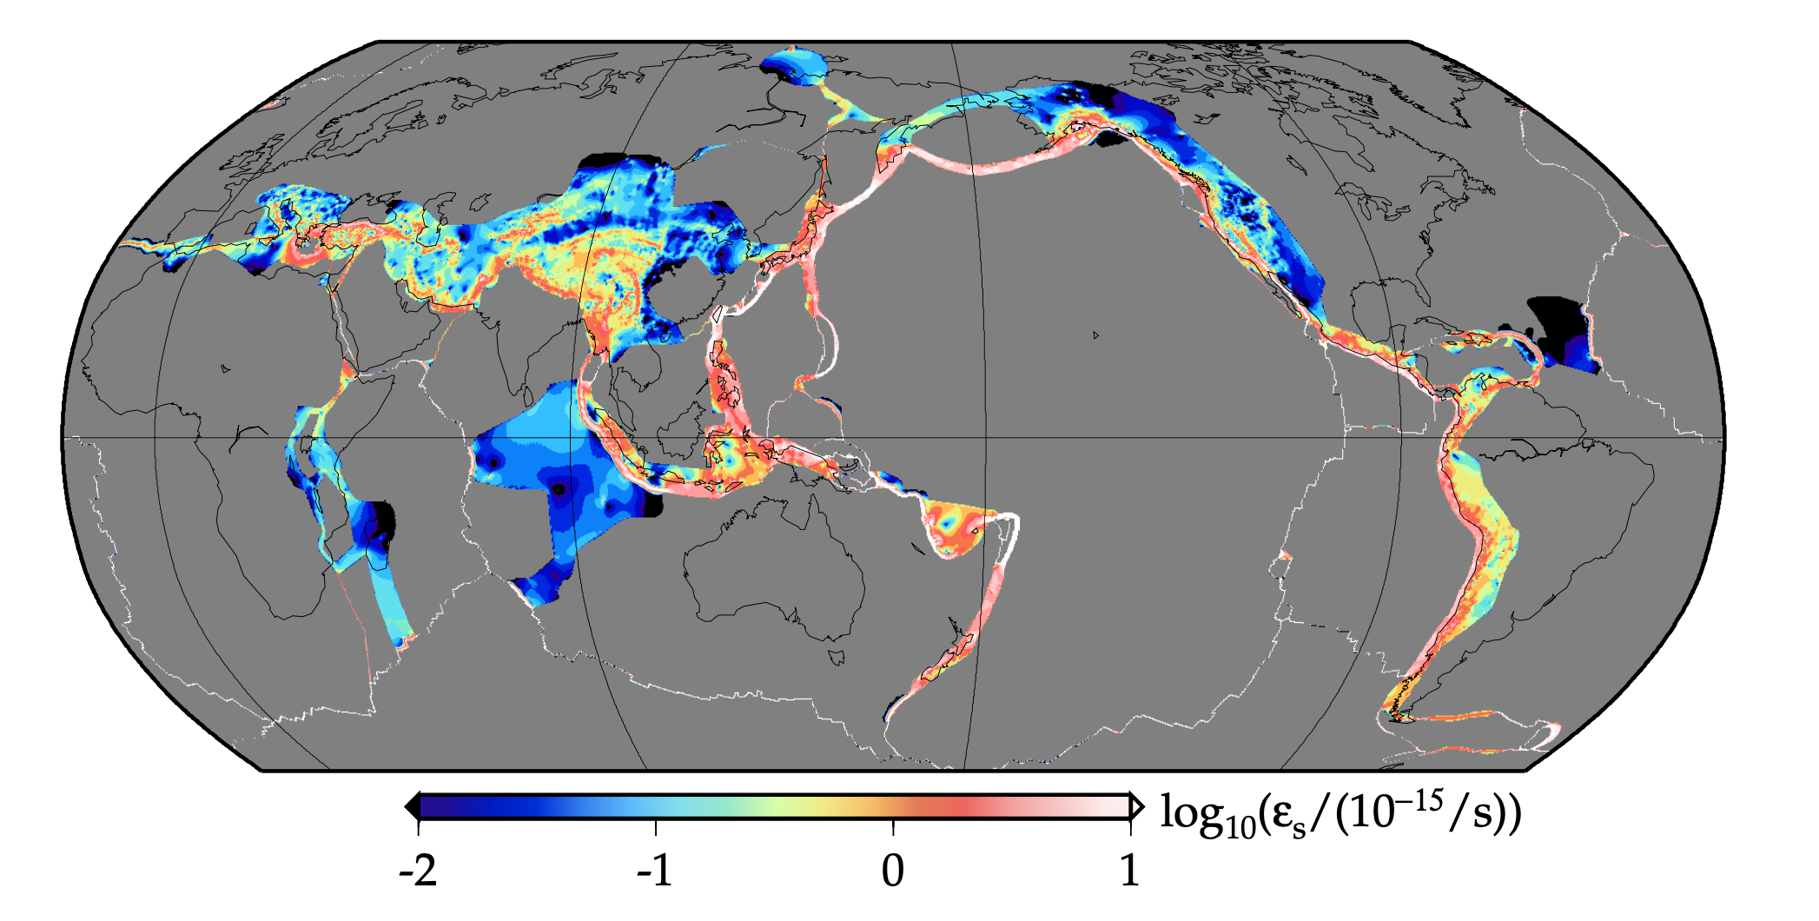
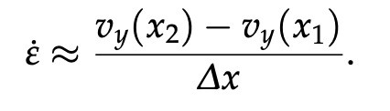
Measuring strain and strain rate on Earth
Geodesy (strain rate) - GPS
Becker & Faccenna

Slide 14
Measuring strain and strain rate on Earth
Geodesy (strain rate) - GPS
Plate tectonics (1960s!): Deformation concentrated at plate boundaries

Slide 15
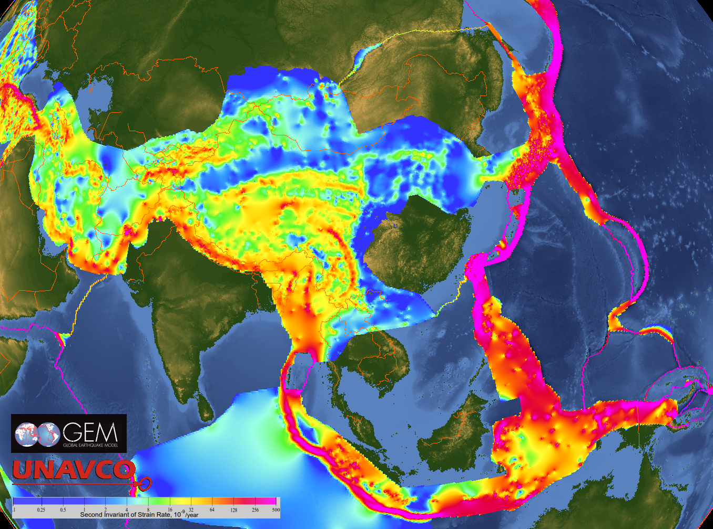
Strain rate on Earth
Not so within within deforming continents, but a reasonable first-order approximation.

Slide 16
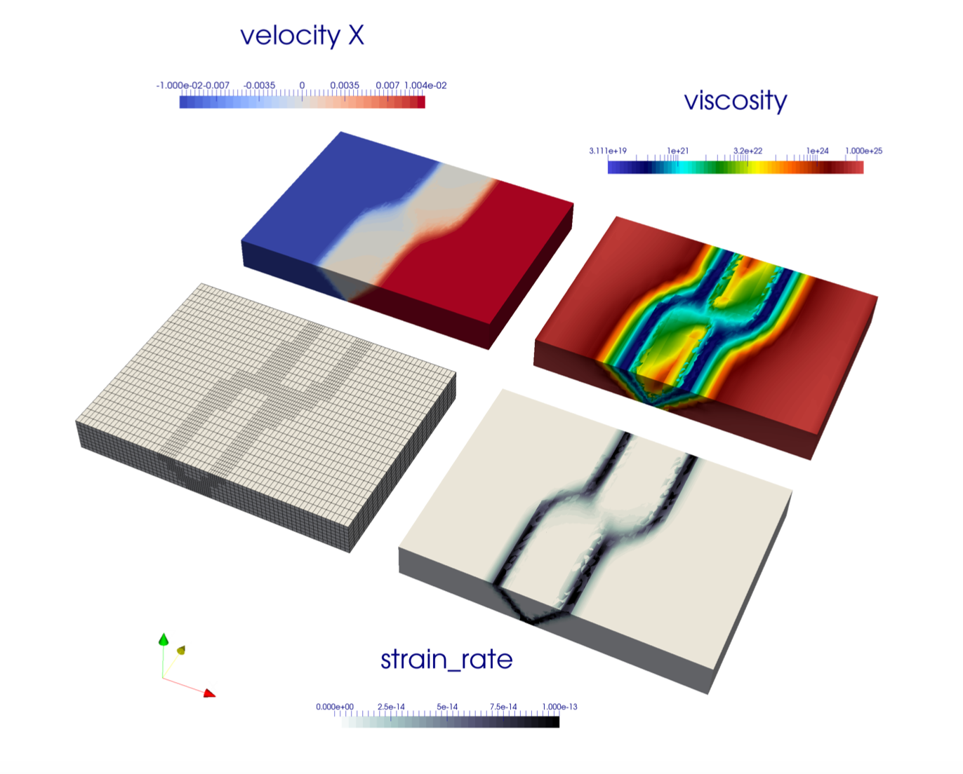
Strain rates in a geodynamic rift model
https://philheron.com/imperial-feb-2018/

Slide 17
Take homes:
Strains and strain rates describe the kinematics of continuum deformation.
Strains are spatial gradients in displacement
Strain rates are spatial gradients in velocities
Deviatoric strain and strain rates tensors
All are 2nd ranks tensors
Next class: Stresses

